Slide 1
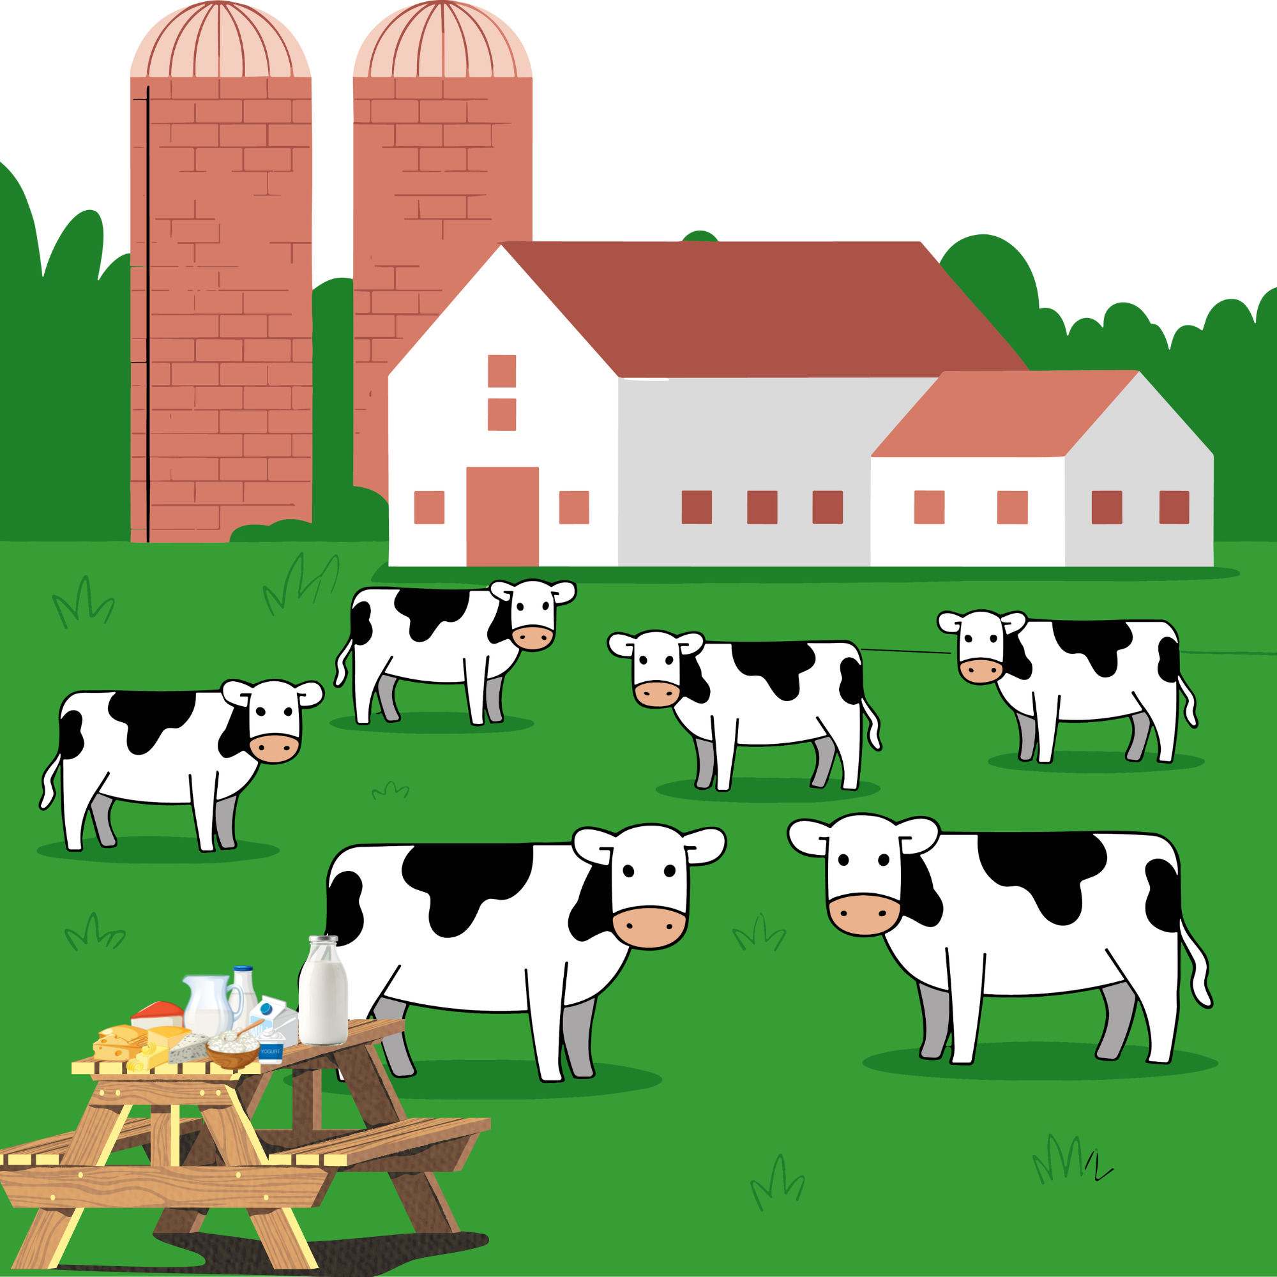

Smart and Sustainable Dairy Production in Bavaria version 1.0 19.11.2025

Slide 2

Team
Group 6
Prudence Avilia Muhambe
Yatin Yatin
Priyabrata Das
Syed Ali Hussain
Waleed Ahmed

Slide 3
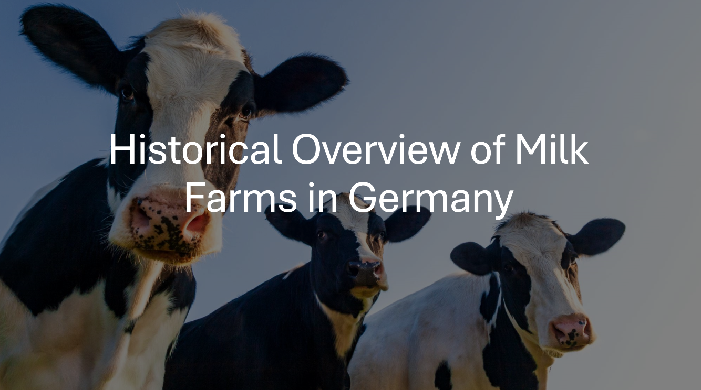

Slide 4
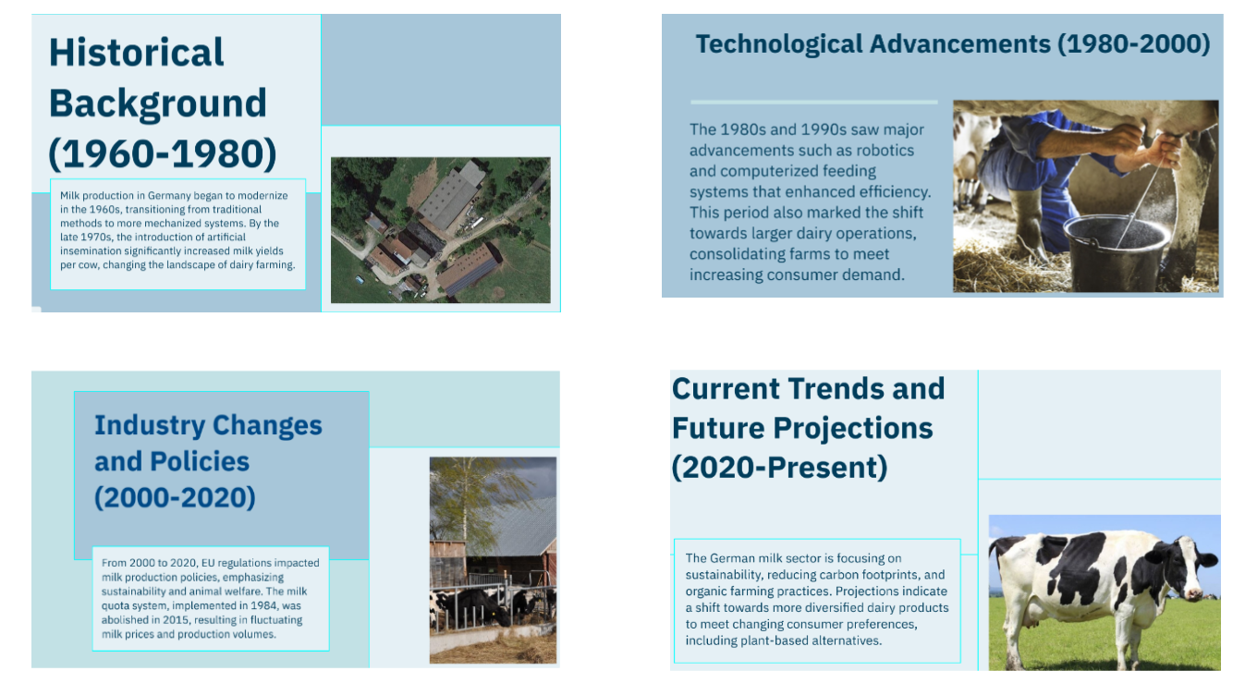

Slide 5
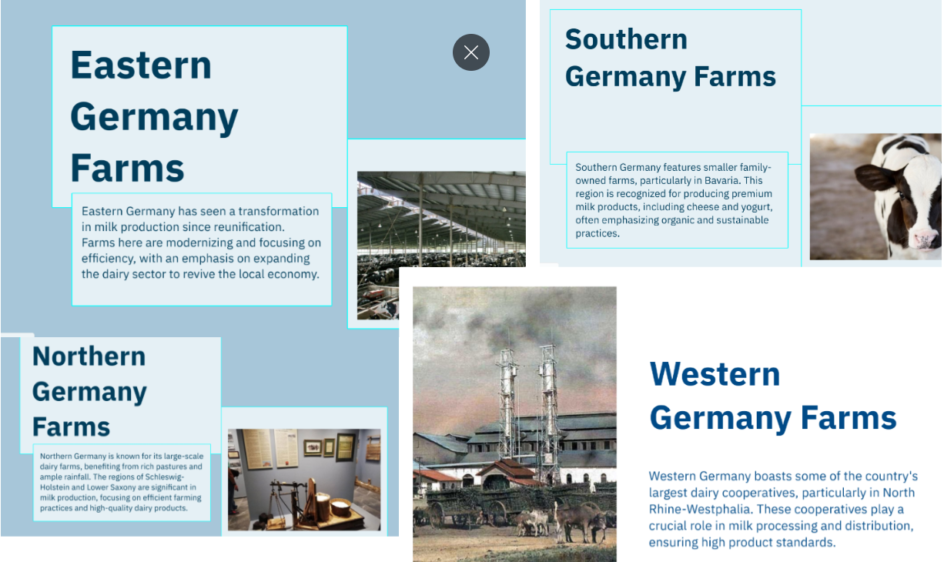

Slide 6
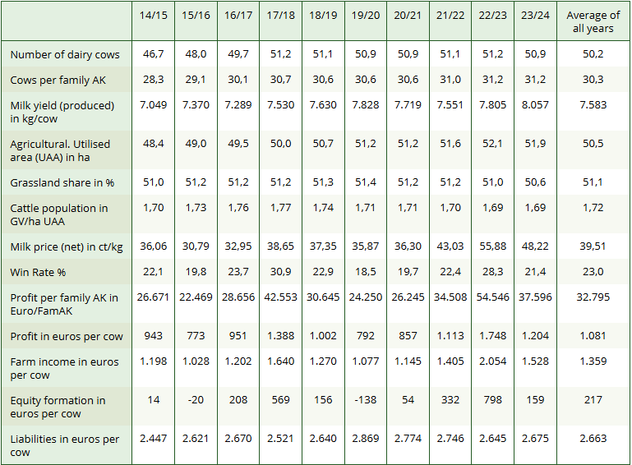
Conventional Milk Production

Slide 7
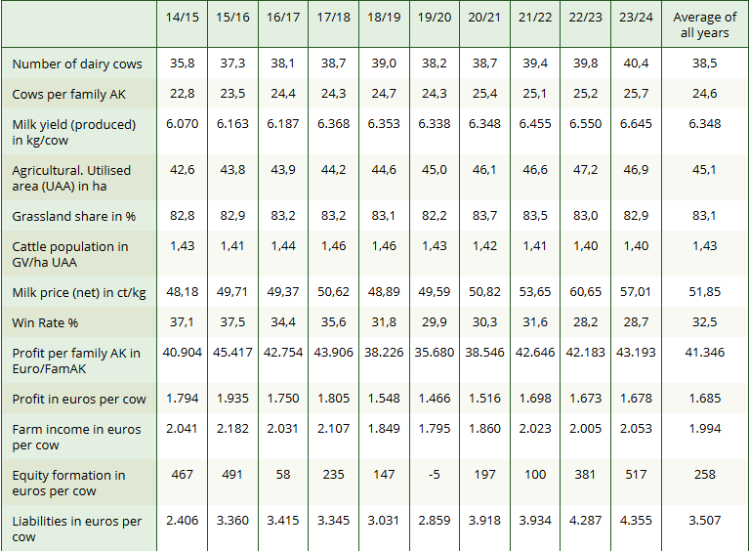
Organic Milk Production

Slide 8
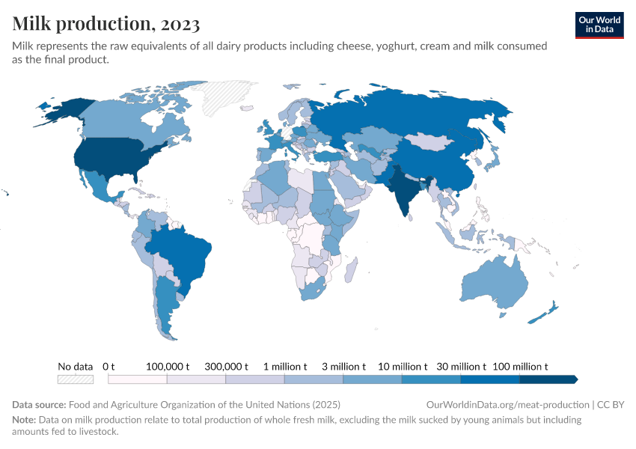
Global Milk Production

Slide 9
Milk Production: EU & Bavaria
965.7 Mt
Global
EU
32.6 Mt
Bavaria
7.72 Mt
Sources (FAO, LfL, BLE, etc.)

Slide 10
Organic Milk Production

Slide 11
Germany Milk YTD Production (Kt)

Slide 12
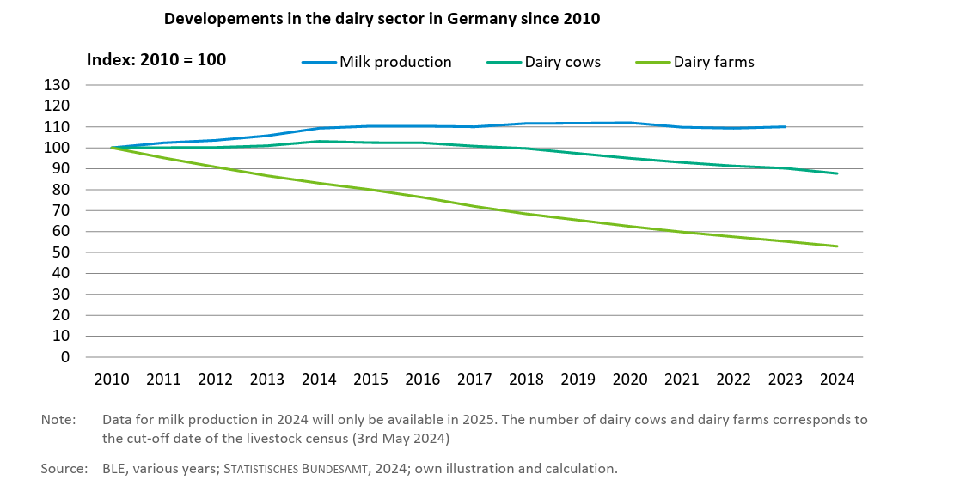
Dairy Sector Developments

Slide 13
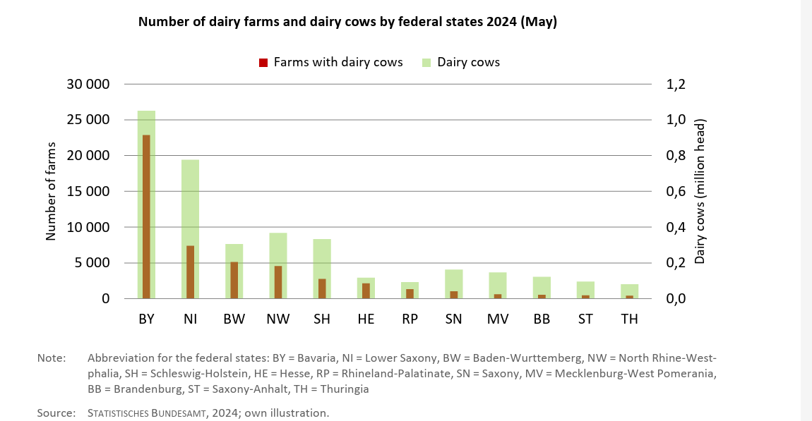
Farm Structure

Slide 14
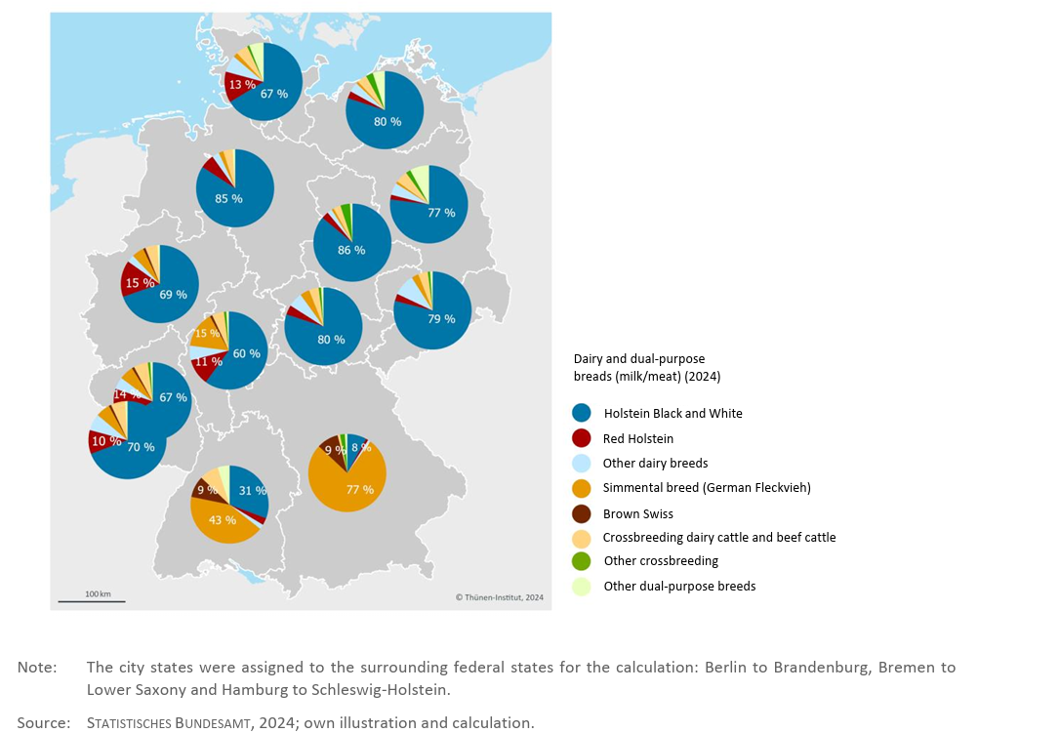
Population Mix- breed

Slide 15
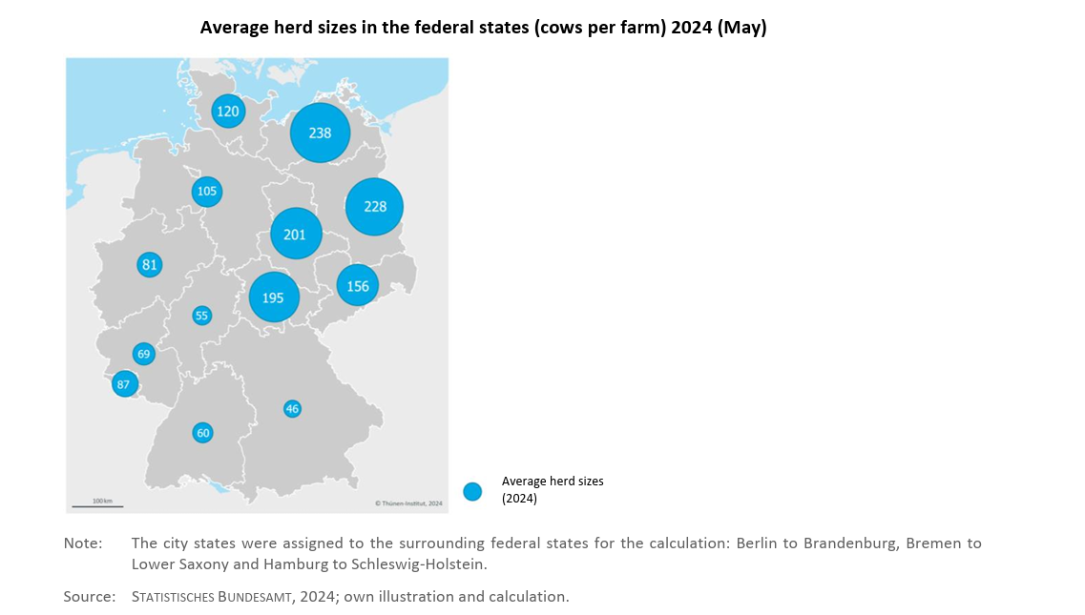
Herd Size

Slide 16
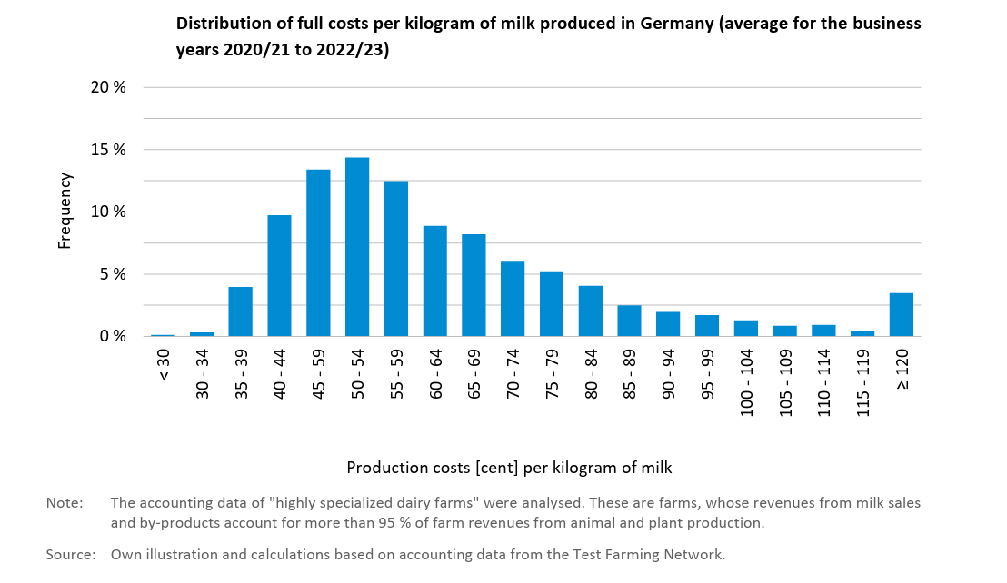
Cost of Production

Slide 17
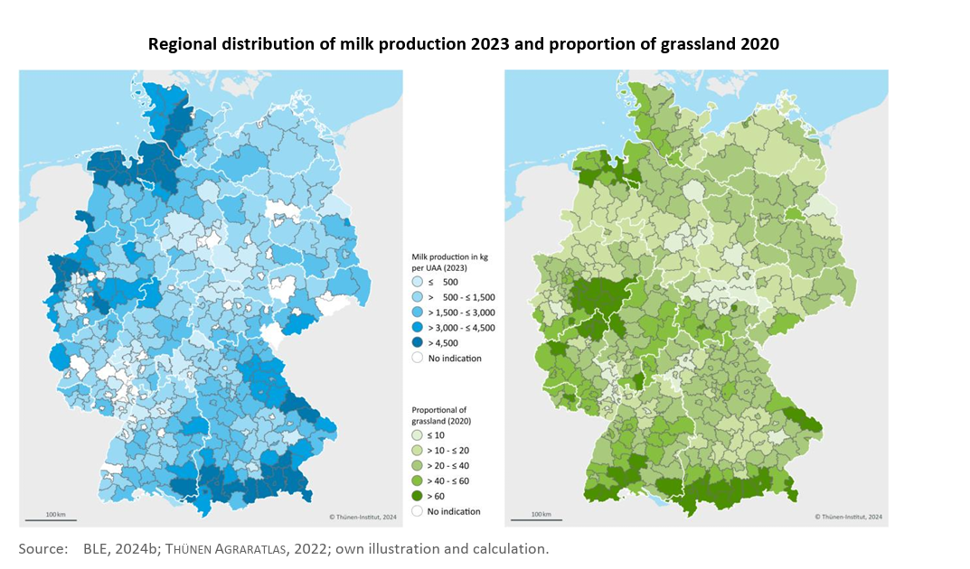
Regional Distribution

Slide 18
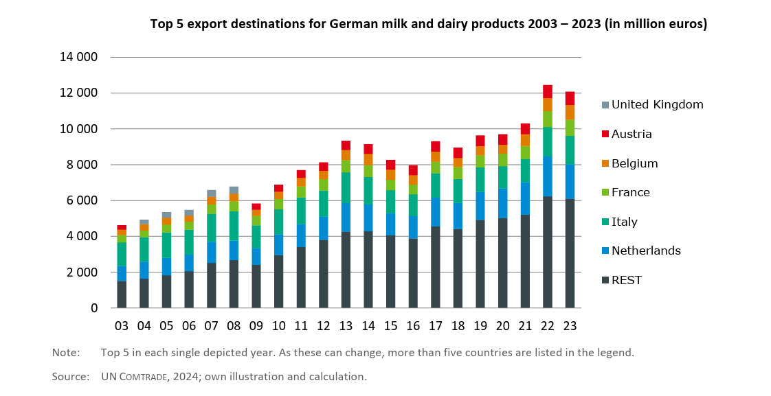
Export

Slide 19
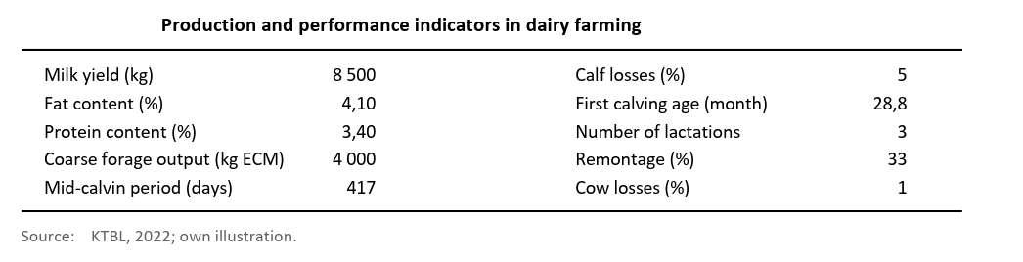
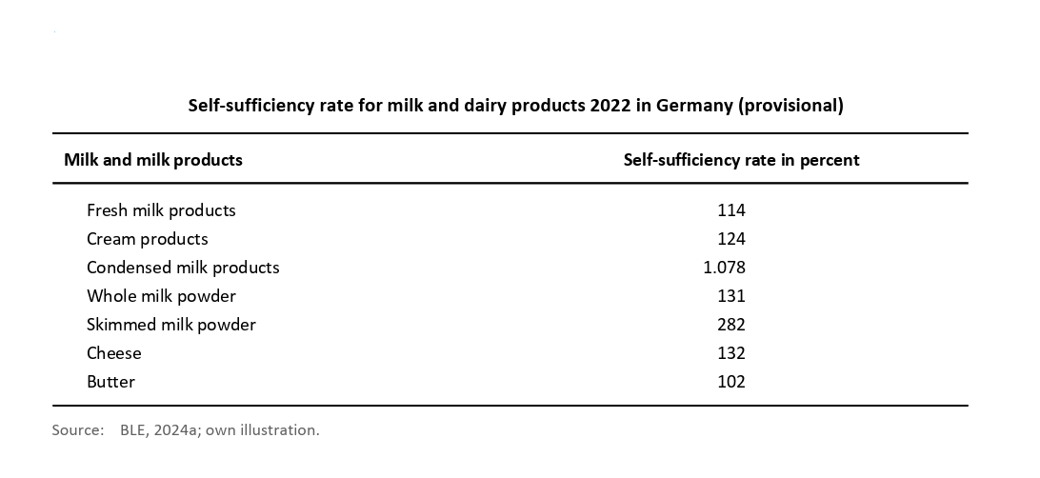
Key Performance Indicators

Slide 20

BAVARIA: The concentration of Heritage and Value.

Slide 21
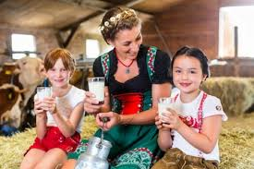
Bavaria is strategically important due to its specialty focus, it's sheer volume of farms, and its high-value product portfolio :
Farm structure : Bavaria is home to almost half of dairy farms in Germany ( 22,455 farms)
Specialty leadership : Bavaria contributes to 20% of milk in germany but produces nearly 50% of German organic milk and it is the largest producer of cheese in Germany
'' Bavaria competes on quality , not just volume.
Sources: Destatis, Bayerisches Staatsministerium für Ernährung, Landwirtschaft und Forsten (Bavarian State Ministry for Food, Agriculture and Forestry
Image source : Freepik.

Slide 22
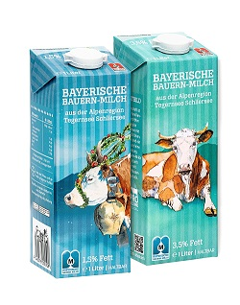
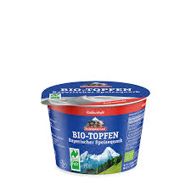
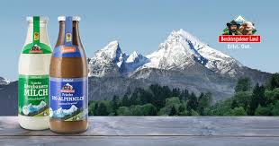
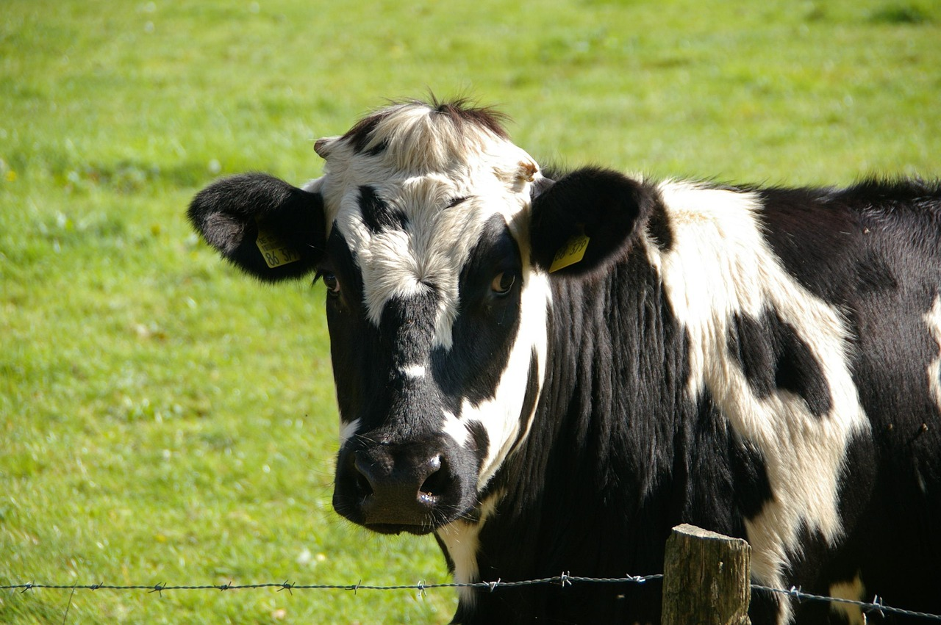
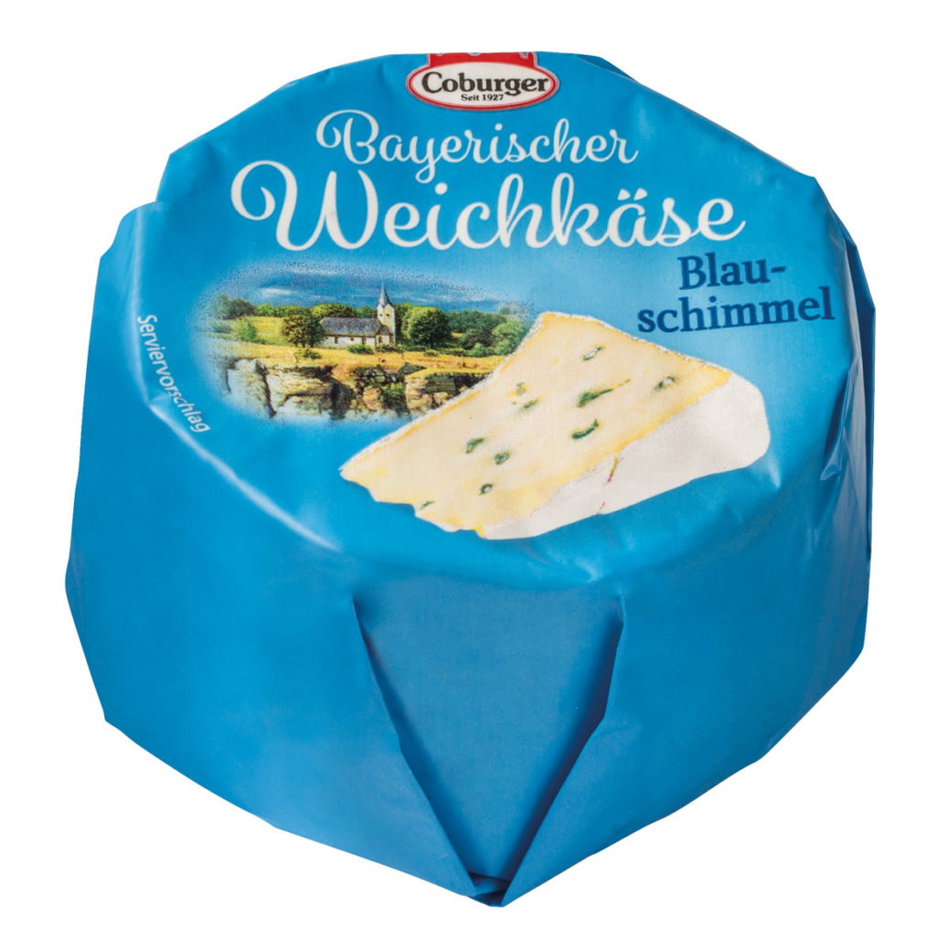
BAVARIA'S DAIRY POWER HOUSE Business & Market

Slide 23
Bavarian Dairy Economy.
Dairy is the most important single production branch in Bavarian agriculture.
Its contribution to overall agricultral production value is significantly more pronounced than the national average making it the bedrock of the regional rural economy.
According to Bayerischer Agrarbericht 2024( Bavarian Agricultural report), based on 2022 figures, milk was the dominant product .
This signified and continues to signify its role on economic pillar of Bavarian Agriculture.
The table on the next slide shows the total production values of different agricultural products in 2022.
Sources: https://www.lfl.bayern.de/mam/cms07/iba/dateien/viertelauswertung_spezialisierter_milchviehbetriebe_23_24_voll.pdf

Slide 24
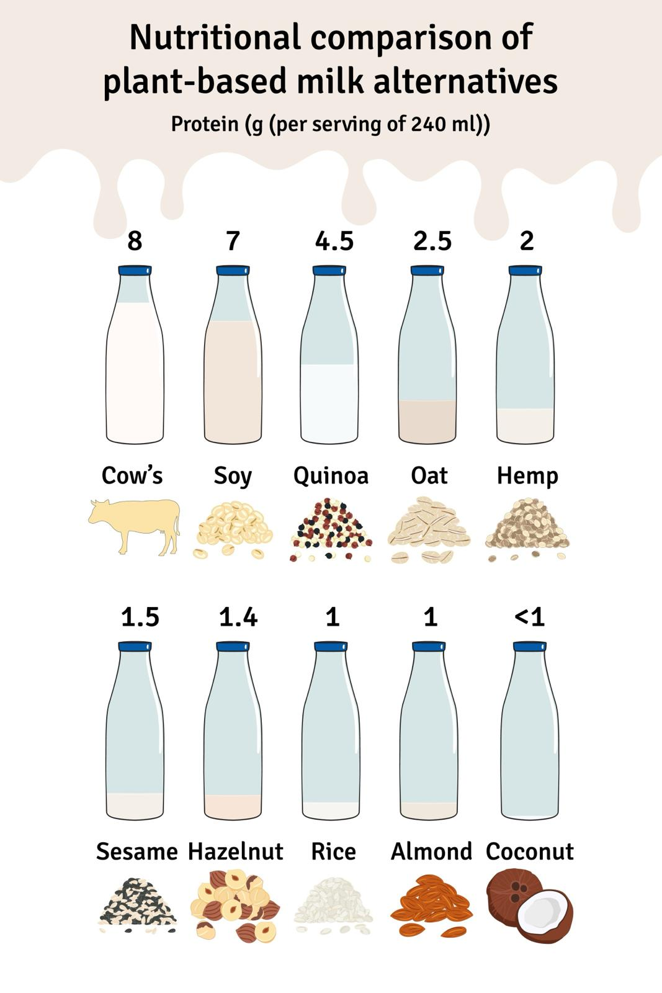
MARKET DRIVERS: The forces reshaping Bavarian dairy.
Market Dynamics: The key Drivers of Strategic Change .
The market is rapidly shifting toward organic and lactose free products , defining a key opportunity. This shift, alongside the threat from plant-based substitutes and the constant price vs quality tension, necessitates a refined strategy.
Source: Market Research Reports, Consumer Trends Analysis

Slide 25
Value Chain Analysis: Alpine Pasture To Global Shelf
The value chain transforms high quality raw milk( often from Simmental cows) into stable high value consumer goods.
Value is disproportionately captured in the Processing and Distribution stages, which is critical for profitabily
Focus: Processing is the critical stage that converts volatile raw material into stable, high – value specialty goods. It is the primary point of value addition, risk mitigation and structural power.

Slide 26
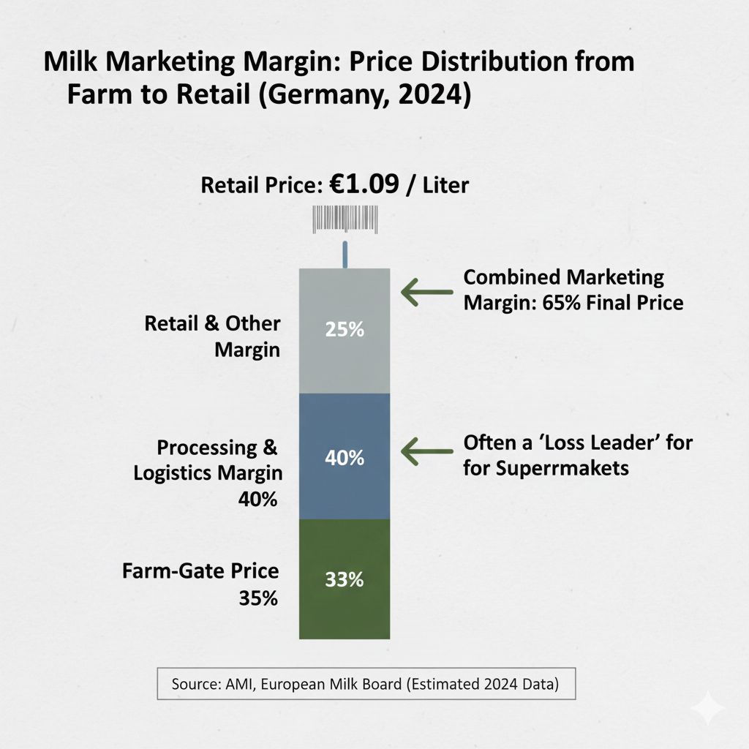
ANALYSING PROFIT DISTRIBUTION: Marketing Margins Raw milk price is set by global commodity markets. The Marketing Margin (Retail Price –Farm price- Costs) highlights that value is heavily captured by processing and retail activities, with liquid milk often used as a retail 'loss leader' Source: AMI ( Agrarmarkt Informations -Gesellschaft), European Milk Board (For cost/price discussions), Academic Literature on German Retail Concentration.

Slide 27
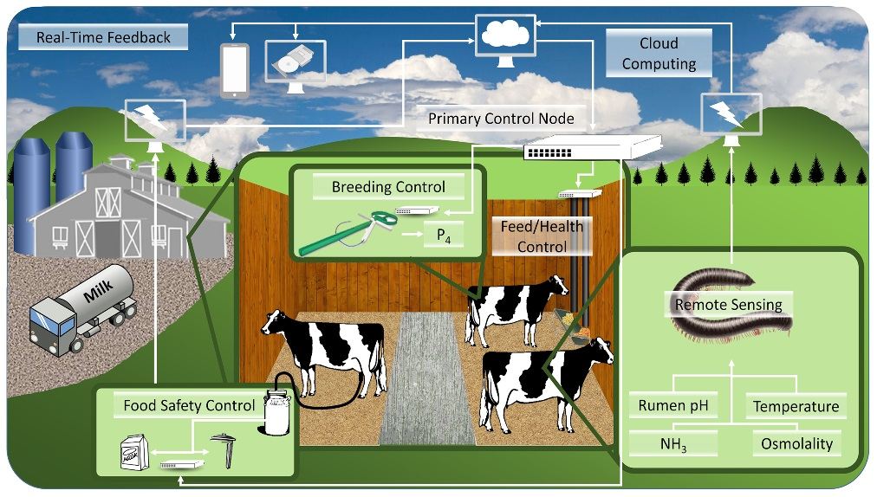
Precision Dairy Farm
Source: https://www.purdue.edu/

Slide 28
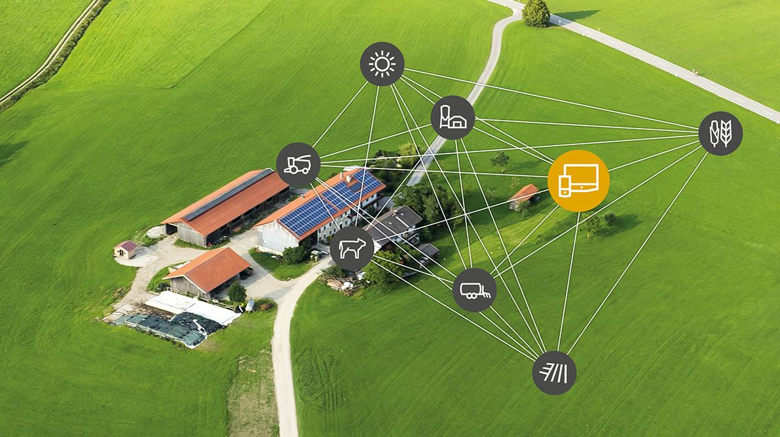

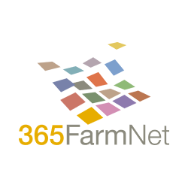
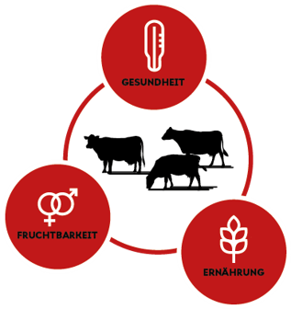
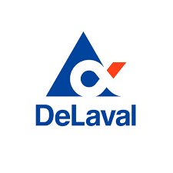

Technology Landscape
Digital Farming
Energy Management
AI
Farm-management platforms

Slide 29
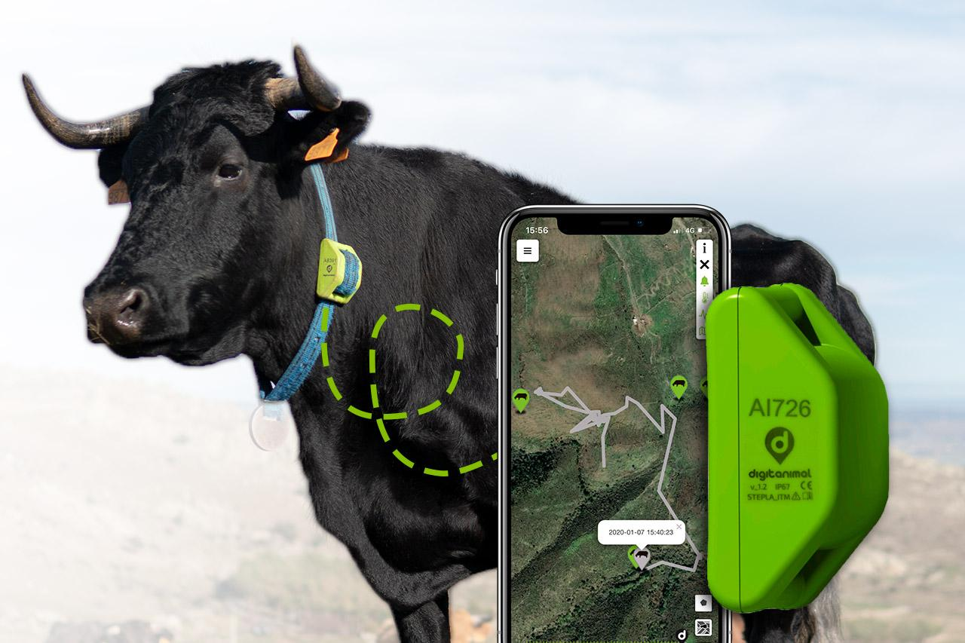
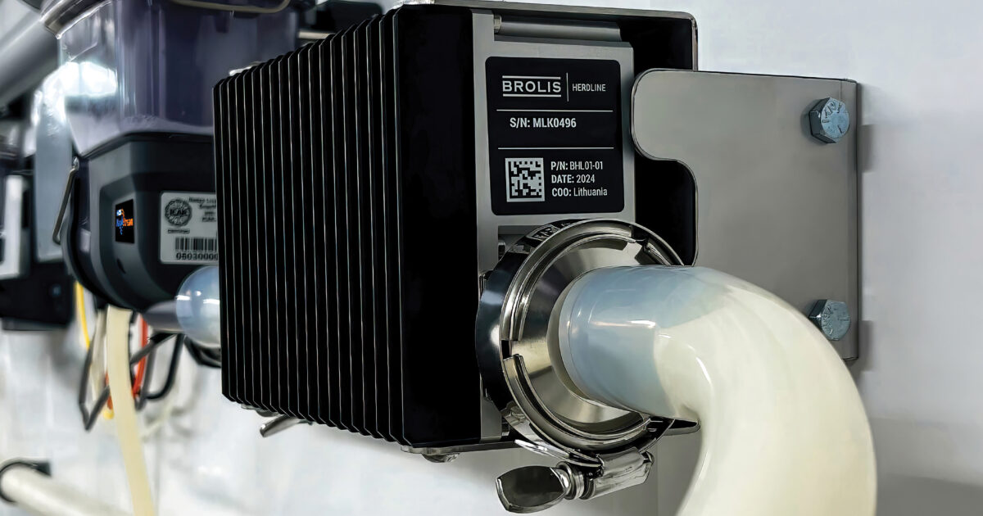
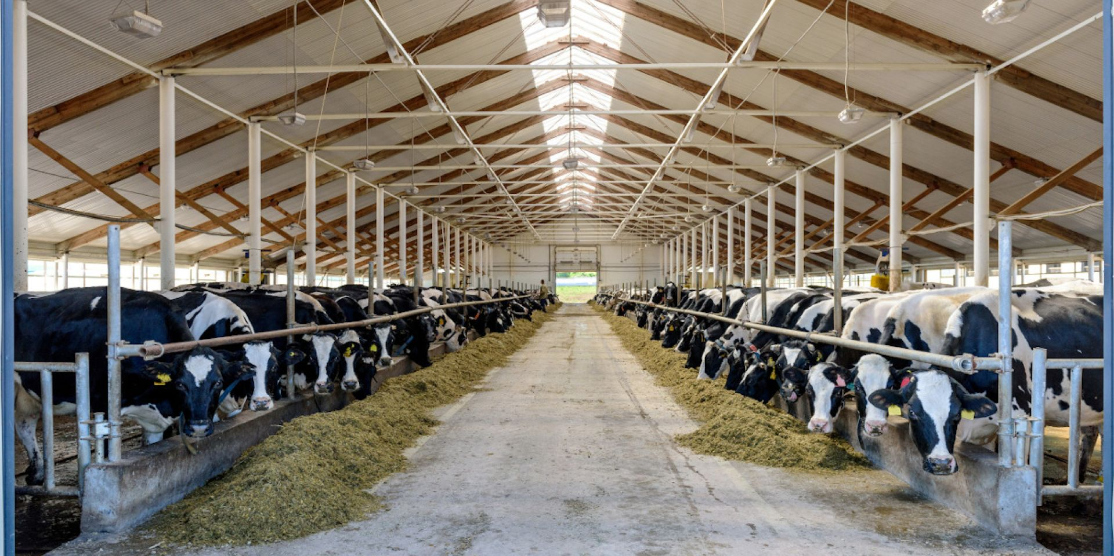
Technology - Deployed
Pedometer collars
Rumination sensors
Ear tags
Location Tags
Milking Robots
Milk Analyzer
Milk Tank Sensor
Temperature
Humidity
Ammonia
Water level
Cameras
Cattle Monitoring
Milk Production
Environment Monitoring

Slide 30
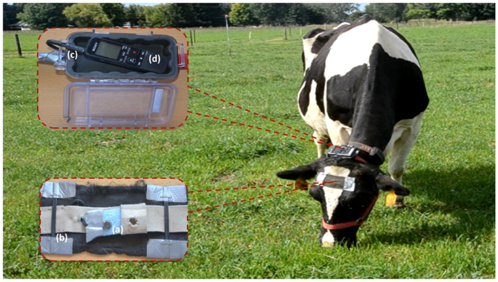
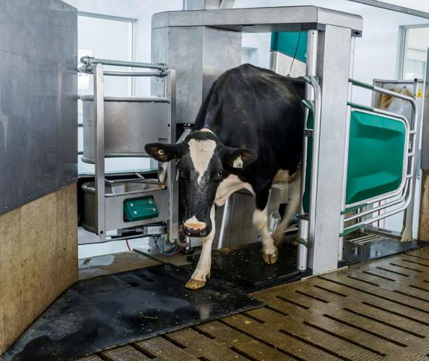
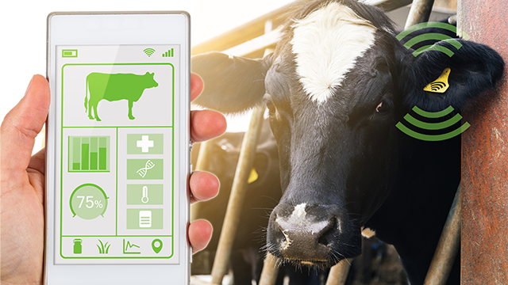
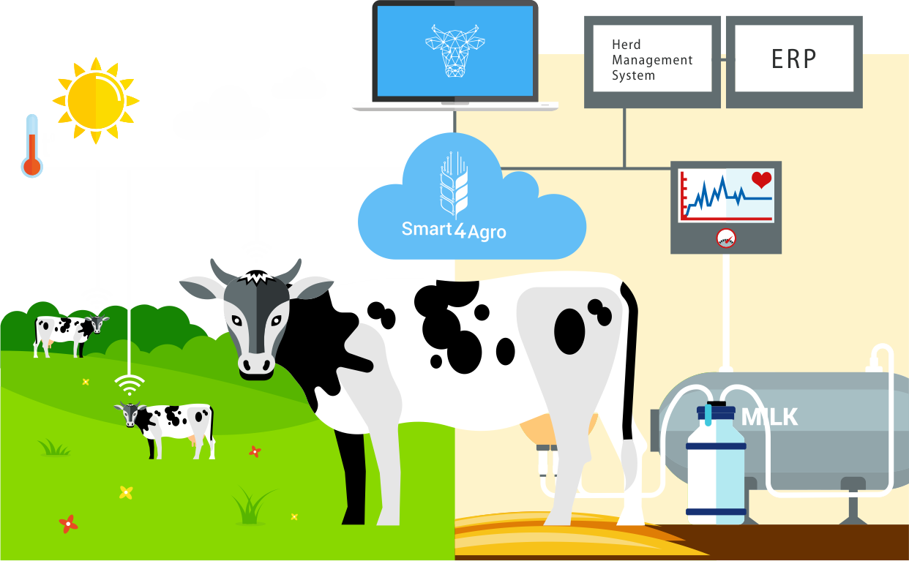
Technology - Potential
Wearables
Early health / heat detection
Milking Robots
More frequent milking
Smart Feeding
Optimal Nutrition
Smart Barn Sensors
Lower Heat Stress
AI Monitoring
Early lameness / BSC checks
Genetics
Better Milk Potential
FMS
Better decisions

Slide 31
Monitoring and Management
Precision Cow Monitoring
Rumination
Eating Patterns
Body Temperature
Activity
Health Anomalies
Farm Management
Health Alerts
Feed Planning
Milking Data Management
Financial Performance Tracker
Camera and AI
Body condition scoring
Lameness detection
Cow positioning and movement
Mastitis early sign

Slide 32
Growth, Health and Safety
Smart Breeding
Artificial Insemination with genomic data
DNA Scoring
Sexed Semen
Environment
Temperature
Ammonia levels
Ventilation
Lighting
Water Management
Robotic scrapper
Smart Feeding
Automated Feed Pushers (Lely Juno)
Automated TMR mixers
RFID based feed systems

Slide 33
Storage and Logistics
Milk Storage
Milk quality monitoring at BMC
Level and volume sensors
UV and Ozone treatmen
Digital Logs
Milk Logistics
GPS and Route optimization for trucks and tankers
Temperature monitoring for spoilage prevention
RFID tagging of milk batches, containers etc.
Robotic scrapper
Data and Analytics
Track milk collection
Storage Duration
Temperature Log
Demand forecasting
Spoilage prediction
Fleet and equipment predictive maintenance

Slide 34
TCO (Total Cost of Ownership)
Small (50)
AMS Robots: 1
Capex ~€316k → €706k
Opex ~€24k → €82k / year
Medium (150)
AMS Robots: 3
Capex ~€727k → €1.24M
Opex ~€61k → €152k / year
Large (500)
Opex ~€173k → €361k / year
AMS Robots: 9
Capex ~€1.96M → €2.83M

Slide 35
Technology Adoption- Milking Robots
Germany: 48,649 dairy farms in 2024
Accelerated growth (≈15% annual growth)
(50–70%) of new milking-systems are AMS
Source: regional surveys, LfL / TUM / German ag-tech reports

Slide 36
Technology Adoption- FMS
1 in 6 farms (~16%) plan to invest
in digitalization
In 2024, 60% of German farms use
farm management software (FMS)
By 2030, 90% of German farms will use
farm management software (FMS)
Source: regional surveys, LfL / TUM / German ag-tech reports

Slide 37
Challenges
Climate pressure is causing heat stress in cows, resulting in lower milk yield and reduced farm performance.
There is a major labour shortage, and many farmers are aging, making it harder to manage farms efficiently.
Rising production costs for feed, energy, and fertilizer increase financial pressure on dairy farms.
Digital systems like AMS and sensors are often not fully integrated, creating data gaps.
Animal diseases are sometimes detected late, leading to higher treatment costs and milk loss.

Slide 38
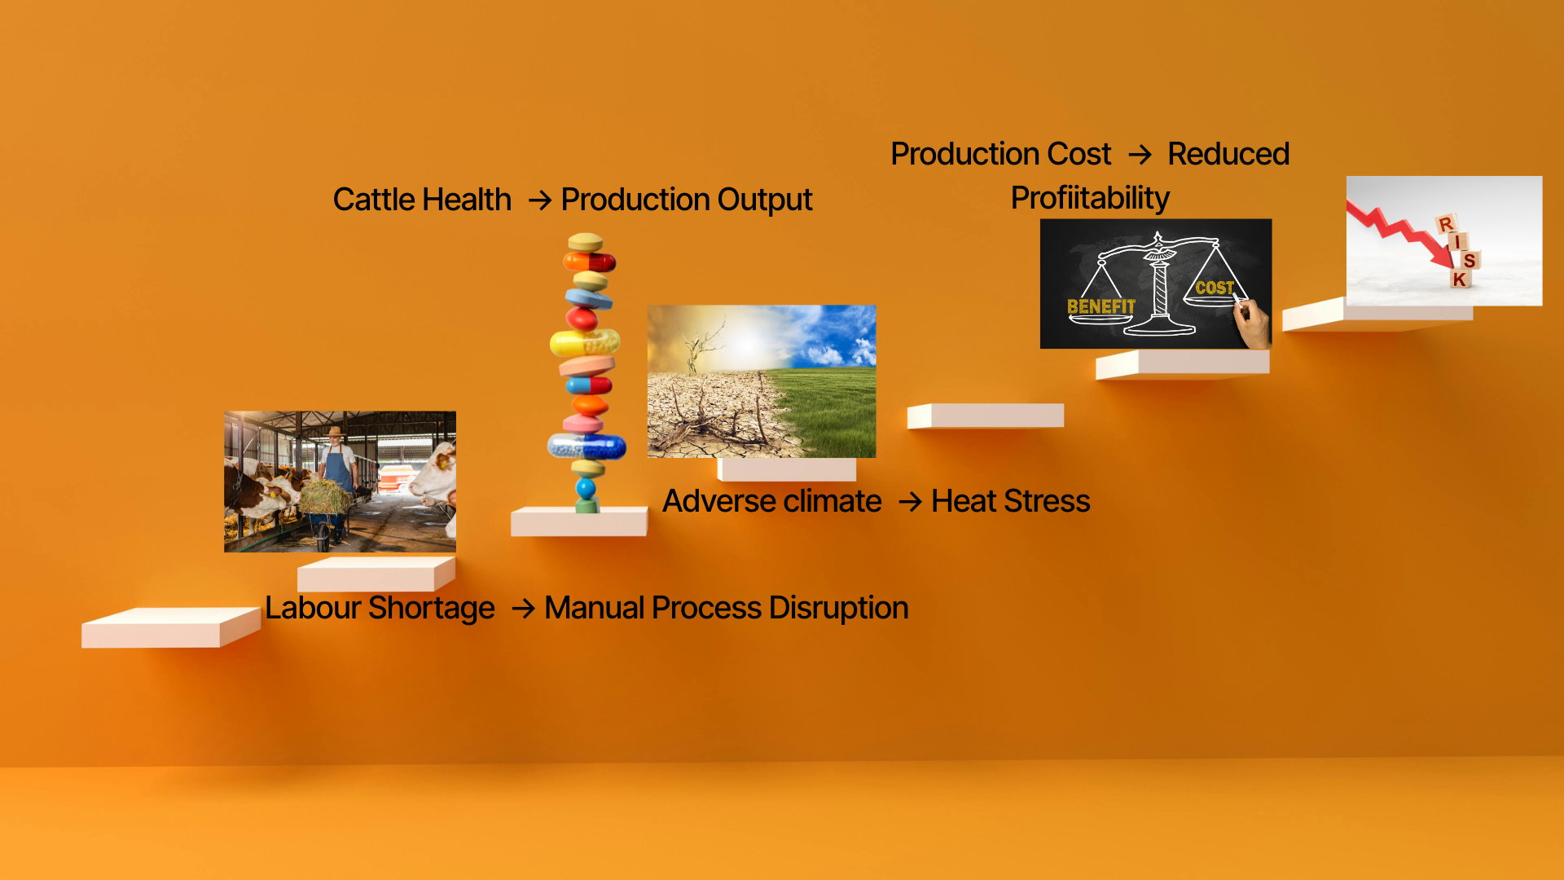
Challenges

Slide 39
SWOT Analysis : Structural Hurdles and Mitigation.(Internal Factors)
Strengths(S) : The greatest asset in the Bavarian Milk sector is it's protected Origin and regional heritage, which enable high product differentiation. This specialization is the industry's main defense against commodity pricing.
Weakness (W) : These are the bottlenecks: The primary vulnerability is the oligopsonistic bottleneck: numerous small farmers are forced to sell to a few powerful processors, leading to suppressed raw milk prices at the farm gate. Critically, the lack of effective advance price contracting (A/C) for conventional milk means the farmer, not the processor, absorbs nearly all global market volatility.
Mitigation Factor : The economic viability of many traditional farms relies heavily on CAP Pillar II payments (e.g., mountain farming subsidies). While essential for sustaining the cultural landscape, this reliance is a structural weakness, as income is dependent on government policy, not purely market forces.
Sources BMEL (Subsidy data), AMI/CLAL (Contracting), Destatis.

Slide 40
External Factors: Opportunities and threats.
Opportunities (O) - Growth drivers: The core opportunity lies in premium segments: the global Organic Boom, leveraging the strong EU quality reputation for Export Growth, and selling the Sustainability Premium—consumers are increasingly willing to pay more for verifiable eco-conscious production.
Threats(T) - Market risks : The most critical substitute is the rise of Plant-Based Alternatives, which directly erode the volume of liquid milk sales. This threat is compounded by Persistent Retailer Price Pressure in the domestic market and rising Regulatory and Climate Costs, which squeeze already tight margins.

Slide 41
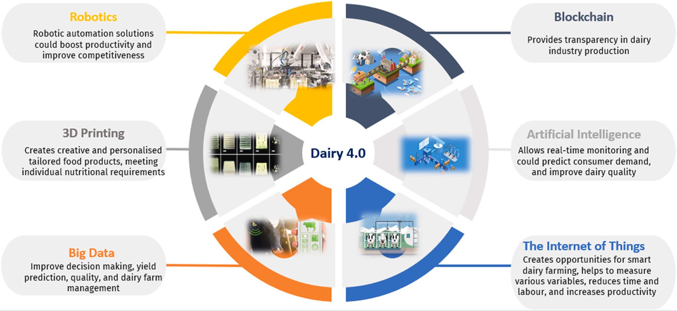
Opportunities- Precision Tech Driven Dairy
Source: https://www.sciencedirect.com/science/article/pii/S266592712300103X

Slide 42
Thank you

